Slide 1

Mission Can-Sat
Delta Lab

Slide 2

Table of Contents
General requirements
Mission Objective
Concept of Operation
Specific requirements
Navigation
OBC
Comms
Structure
Mechanism
Ambient Monitoring
Power
Key Performance Parameters

Slide 3

General Requirements
Stakeholders:
Juan José Rojas Hernandez – Delta Lab
Centro de Innovación en Ciencias Espaciales de Panamá (CENACEP)
Duration of the workshop: 24 hours / 3 days.
Assistants would be divided into 4 groups of 5 people each.
There would be a Delta facilitator per group.
A guide document must be delivered.
The workshop would be divided into 10 units.
Each unit would have its own presentation.
Each group requires the materials listed in the material list.

Slide 4
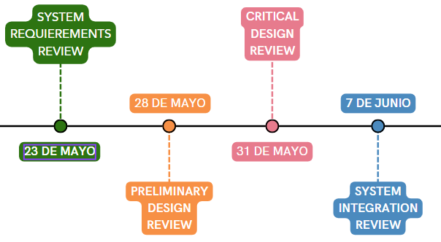
Objective
To generate a technical workshop for the creation of basic Can Sats
Timeline NASA

Slide 5
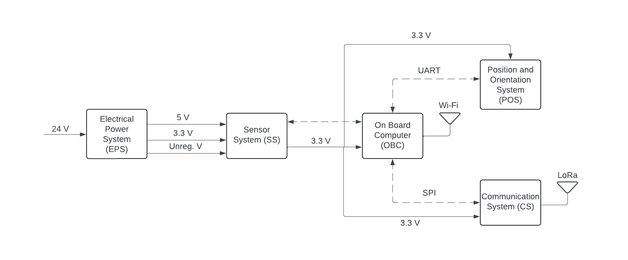
Architecture

Slide 6
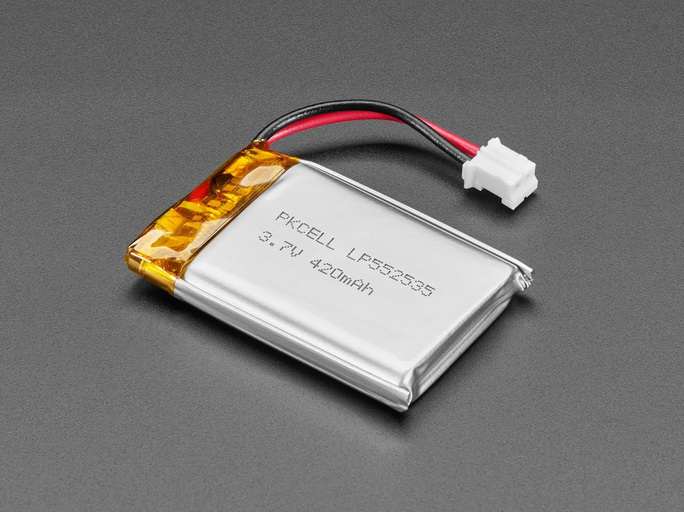
Electrical Power System Specific Requirements
Team Members
Daniela Orozco
María José Angulo
Alejandro Bustamante
Josue Morera
It must be rechargeable.
It must count with a 5V and a 3.3V regulator
It should have a solar panel.
It must be powered by a Lithium-Ion battery.

Slide 7
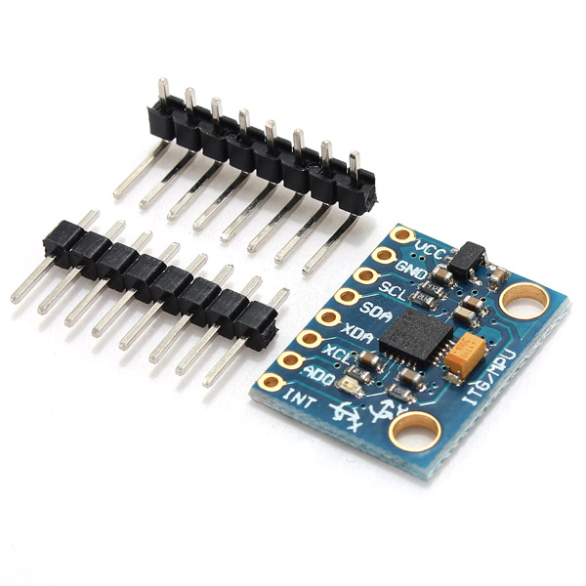
Position and Orientation System Specific Requirements
Team Members
Kaleb Granados
Joseph Muñoz
It must provide IMU information:
Position
Orientation
Rotation
Velocity
Acceleration
Gravitational forces

Slide 8
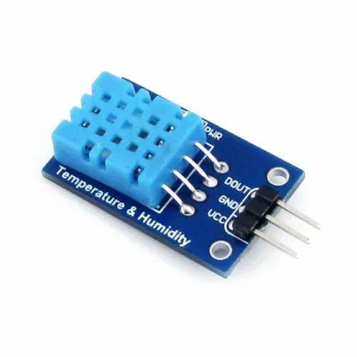
Sensor System Specific Requirements
Team Members
Joseph Muñoz
Nicole Prado
Daniela Orozco
It must provide the next information:
Humidity
Temperature
Pressure - Altitude
Voltage
Current

Slide 9

Communication System Specific Requirements
Team Members
Nicole Prado
Anthony Arguedas
Alexander Solís
Each Can-Sat needs to have a LoRa radio for communication.
There must be a LoRa receiver on ground.
All telemetry must be codified before its send.
The receiver must be able to decode the received messages.
The data should be plotted online.*

Slide 10
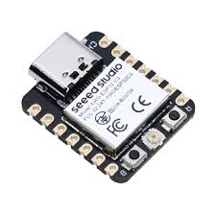
On Board Computing Specific Requirements
Team Members
Anthony Arguedas
Alexander Solís
An ESP32-C3 must be implemented.
The microprocessor must be able to control sensors and actuators.
It should be able to control the deployment of the parachute mechanism.
It must control data send operations.

Slide 11
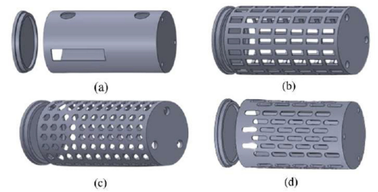
Structures Specific Requirements
Team Members
Angie Cubillo
Kaleb Granados
Catalina Madrigal
It must provide mechanical supports to al modules.
It must resist vibrations.
It must resist the parachute deployment.
It must be the size of a 355 ml can.

Slide 12
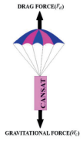
Mechanisms Specific Requirements
Team Members
Josué Morera
Angie Cubillo
Catalina Madrigal
It should ensure that the parachute opens correctly.
Air should be directed into the parachute for its opening.
It should be compact, light and small.

Slide 13

Minimum Success Criteria
To transmit and handling data through LoRa.

Slide 14
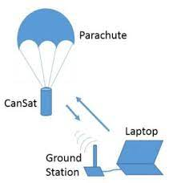
Extra Success Criteria
To design a parachute system

Slide 15

Mission Can-Sat
Lets get down to work! :)

